Slide 1

Instagram user analytics
Trainity project

Slide 2
AGENDA
PROJECT DESCRIPTION
APPROACH
INSIGHTS
TECH-STACK USED
RESULTS

Slide 3

PROJECT DESCRIPTION
This project, aims to create a database-driven system that analyzes Instagram user activity and engagement data. The purpose of the project is to leverage structured data to provide insights into user behavior, engagement patterns, and content performance on Instagram. This insights that can be used by teams of the business to launch a new marketing campaign, decide on features to build for an app, track the success of the app by measuring user engagement and improve the experience altogether while helping the business grow.

Slide 4


APPROACH
1.DEFINING PROJECT OBJECTIVES- Understanding the requirements of this projects to extract meaningful data insights which would be used for future development of the platform.
2.DATABASE CREATION- Creating a database in MySQL workbench with the provided dataset and testing and optimizing the queries for accuracy.
3.DOCUMENTATION AND REPORTING- Providing meaningful insights after documenting the queries and analysing the data to generate desired outputs and conclusions.

Slide 5


TECH-STACK USED
For this project, MySQL WORKBENCH 8.0.39 by ORACLE was used as this is a user friendly, free for everyone to use, ensures data integrity andgreat for nalysing multiple tables at once.

Slide 6
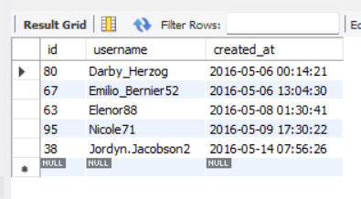
INSIGHTS
A) MARKETING ANALYSIS
1. LOYAL USERS REWARD: The top 5 oldest users of Instagram according to the provided dataset –
QUERY-
SELECT id, username, created_at
FROM usersORDER BY created_at ASC
LIMIT 5;

Slide 7
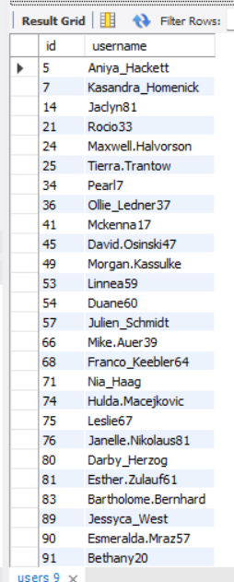
INSIGHTS
2. INACTIVE USER ENGAGEMENT: users who have never posted a single photo on Instagram-
QUERY-
SELECT id, username
FROM users
WHERE id NOT IN (
SELECT DISTINCT user_id FROM photos
);

